Slide 1
NOTABLE PROJECTS WITH TELECOMUNICATION GROUPS

Slide 2
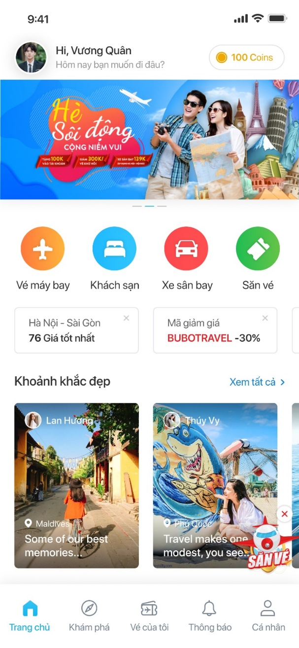
COOPERATED PROJECT WITH MOBIFONE
Target customers:
  Nearly 40 million mobile subscribers.
  8,900 registered staff working as sales agencies in 63 provinces
Summary:
  Cooperate with Mobifone to build and develop an online travelling platform on mobile devices and website – TravelLink, integrated with MOBIFONE Pay e-wallet for payment.
Expected revenue:
  200 Billion VND/year

Slide 3
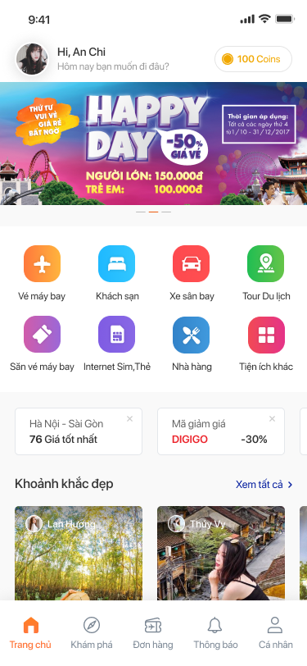
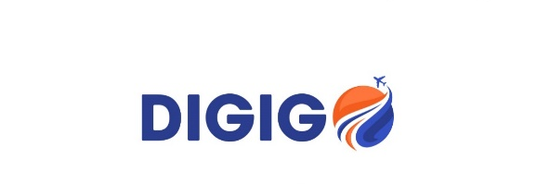
COOPERATED PROJECT WITH VNPT
Target customers :
  Nearly 30 million mobile subscribers.
  40,000 registered staff working as sales agencies in 63 provinces.
Summary :
  Cooperate with VNPT to build and develop an online travelling platform on mobile devices – DIGIGO, integrated with MOBIFONE Pay e-wallet for payment.
  Developing a system of travel agencies, digital tourism services to become a distribution channels in 63 provinces.
Expected revenue :
  200 Billion VND/year

Slide 4
NOTABLE PROJECTS WITH VIETNAMESE BANKS

Slide 5
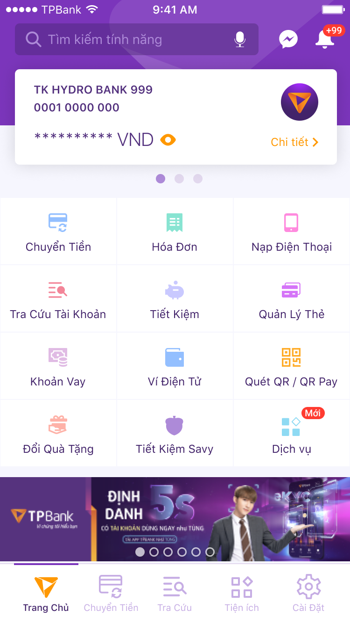
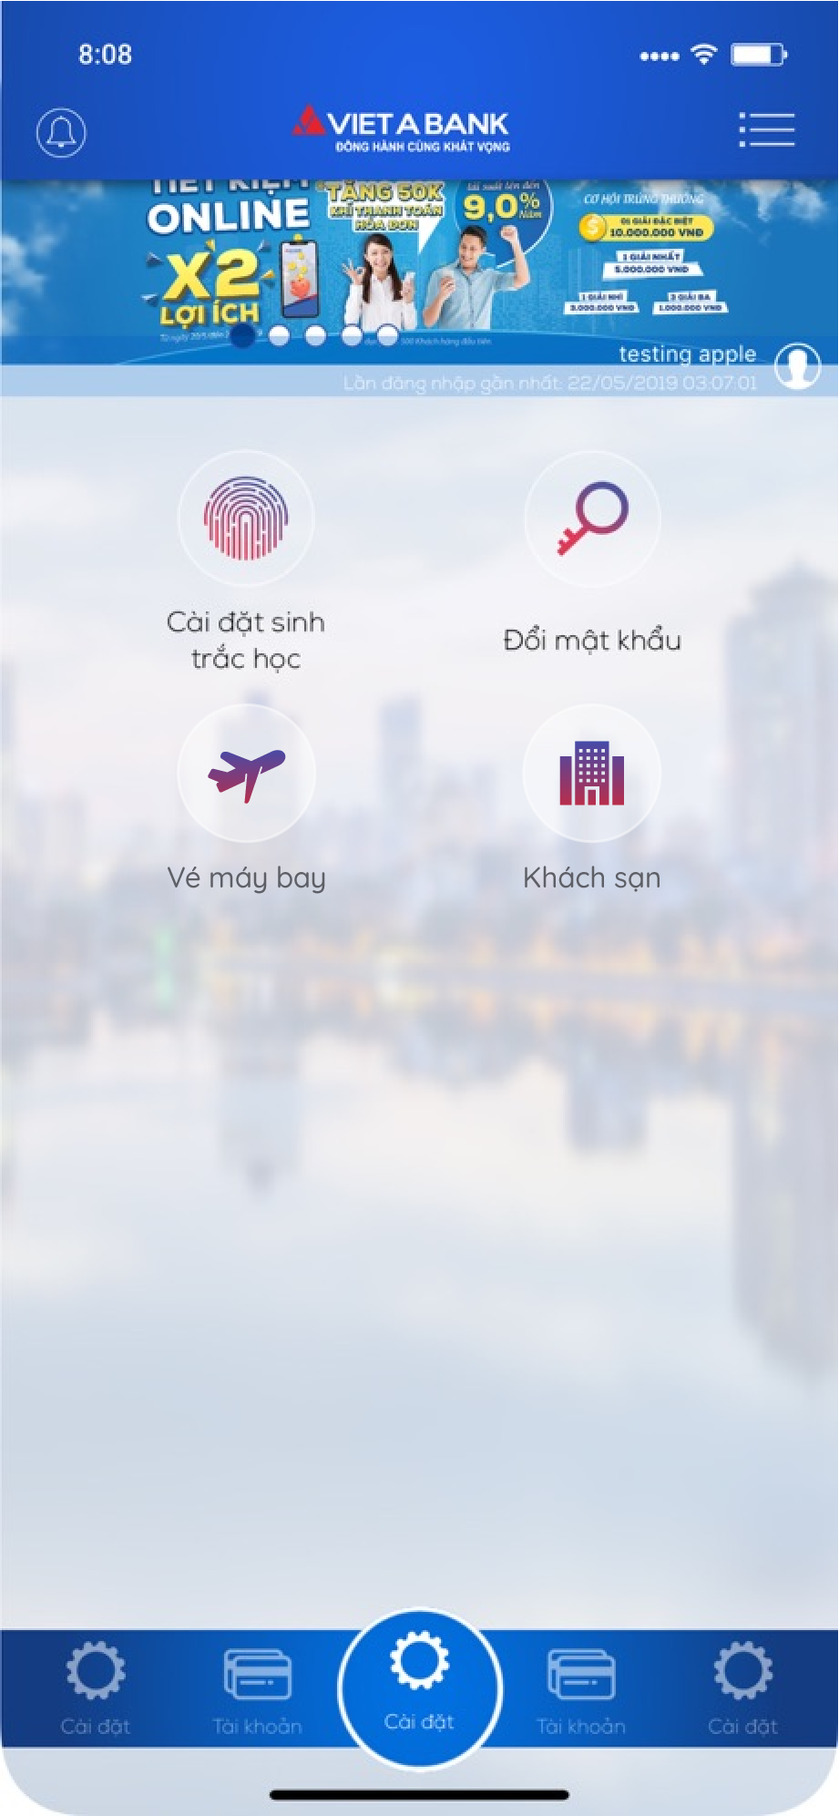
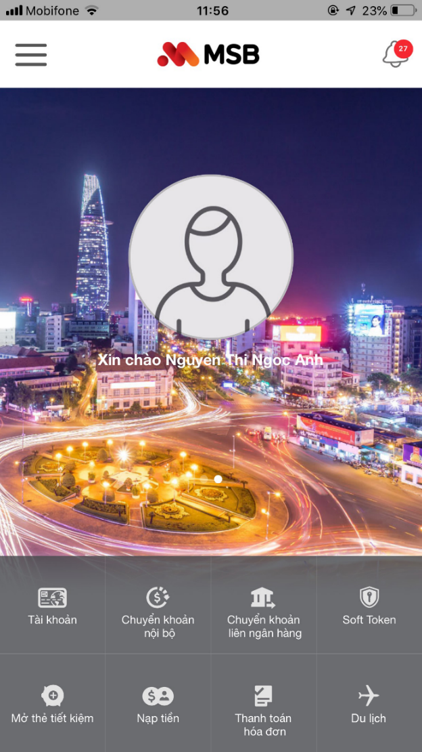
COOPERATED PROJECTS WITH BANKS
COOPERATE WITH TP BANK
COOPERATE WITH VIET A BANK
COOPERATE WITH MSBANK

Slide 6



COOPERATED PROJECTS WITH BANKS
 | Potential customers | Estimated or commenced date | Expected revenue | Nội dung hợp tác
 | 03 million customers | 02/04/2021 | 10 tỷ/năm | To integrate online ticketing services, hotel room and travel combos booking on TP Bank’s application
 | 2.5 million customers | Expected to operate in 07/2021 | 8 tỷ/năm | Build and develop a complete travel ecosystem which encircled customers travelling needs by various feature. The product is integrated in to MSB application.
 | 02 million customers | Expected to operate in 08/2021 | 5 tỷ/năm | Cooperate with VietABank to implement online ticketing services, hotel room and on VietABank App and at VietABank transaction counters.

Slide 7



MANAGEMENT TEAM
Ms. Nghiem Thu Ha
Mr. Le Trong Tuan
Mr. Nguyen Tien Lam
CEO 8Travel Founder VNLink
Chairman VNLink CEO VNLINK
CEO VNLink Founder

Slide 8















NOTABLE CUSTOMERS AND PARTNERS

Slide 9
BUSINESS PROPOSAL
NETFLIX – VNLINK
June, 2021

Slide 10

CONTENTS
VIETNAMESE MARKET
NETFLIX CURRENT SITUATION IN VIETNAM
PROPOSAL
REASONS TO COOPERATE
SCOPE OF WORK
MARKETING
BENEFITS

Slide 11

VIETNAMESE MARKET
Covid-19 Pandemic has heavily shifted customer behavior and habit since it has increase the number of digital customers:
  Vietnam has 70% of its population using mobile phones with a total of 150 million subscriber, 64% of which are connected to 3G and 4G.
  Currently, there are 35 active businesses providing online streaming services, with 14 million subscribers.

Slide 12

NETFLIX CURRENT SITUATION IN VIETNAM
Netflix ranks 2nd in the top 5 most popular online streaming services in Vietnam, behind FPT Play
In April 2020, there were more than 3.5 million mobile devices installed Netflix
In June, Netflix has just launched the Netflix Mobile Plan package on mobile devices with a cost of 70,000 VND/month

Slide 13
PROPOSAL
VNLink proposed to cooperate with Netflix:
“as a distributor of Netflix's streaming services to telecommunication groups in Vietnam (including Mobifone, Vinaphone and Viettel) to deploy DATA packages to mobile subscribers.”

Slide 14
PROPOSED DATA PACKAGE
Description:
  The package is for subscribers of Mobifone, Vinaphone and Viettel when accessing Netflix.
Target customers:
  150 million mobile subscribers from Mobifone, Vinaphone and Viettel
Package information:
Name | Benefits
Daily package | Free unlimited data access with high-speed roaming to Netflix wapsite and Application.
Monthly package | 3GB of high-speed roaming data Free unlimited data access with high-speed roaming to Netflix wapsite and Application.

Slide 15


REVENUE SHARING
If a package is successfully sold to a subscriber, Netflix will receive the following revenue:
  Daily package: 2,000 VND/pack
  Monthly package: 50,000 VND/pack
Get a commission for each Netflix package sold from the telecommunication groups
From the cooperation, marketing, and advertising with telecommunication groups.

Slide 16






REASONS TO COOPERATE
THE FIRST COMPANY TO DELIVER THE SERVICE IN VIETNAM
UTILIZING THE TELECOMMUNICATION COMPANY CUSTOMERS
USING BIG DATA FROM NETWORK PROVIDER
A STRATEGIC PRODUCT IN COMBINATION WITH E-WALLET FROM NETWORK PROVIDER
NETWORK PROVIDER IN CHARGE OF COMMUNICATION
CUSTOMERS IS ABLE TO ENJOY COST-EFFECTIVE DATA PLAN AND OTHER SERVICES
Notes:
Dơn vị đầu tiên triển khai
Hợp tác với nhà mạng => được sử dụng các ích lợi mà nhà mạng cung cấp
Khach hàng có sẵn của nhà mạng
Tích hợp gói data sẵn có của nhà mạng

Slide 17


SCOPE OF WORK
To sign Business Cooperative Contract with VNLink
To provide Netflix digital content to VNLink.
To cooperate with VNLink to create marketing plan
To sign Business Cooperative Contract with Netflix
To sign Business Cooperative Contract with Telecommunication Groups
To cooperate with Netflix to create marketing plan
To work with Vietnam telecommunication groups on implementing Netflix package.
To solve any problems arise from Telecoms
To sign Business Cooperative Contract with Netflix
To Collect package fee from mobile subscribers
To Carry out marketing activities to end-users
To provide promotion 3G DATA to customers

Slide 18
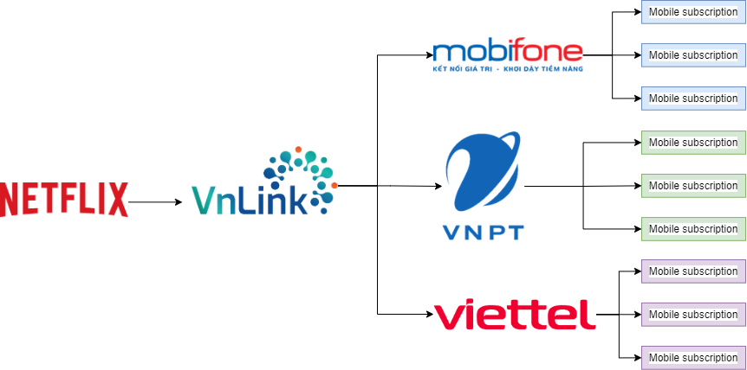
COLLABORATION MODEL:
SERVICE
PROVIDER
DISTRIBUTOR
PARTNERS

Slide 19

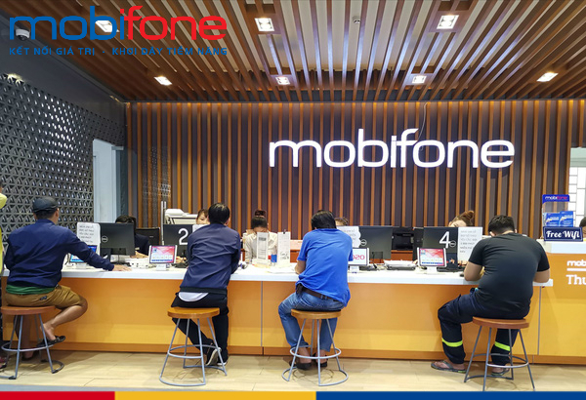

MARKETING
The telecommunication companies is able to provide marketing support via:
1. Interactive Voice Response systems.
2. Adverting SMS to registered Mobile subscribers.
3. Telecommunication groups showrooms, stores in 63 provinces.
4. Online and offline marketing campaign.
VNLink and Netflix will collaborate on creating a marketing strategy and marketing plan.
We will cooperate strictly with Telecommunication companies to meet marketing requirements from Netflix.

Slide 20
PROJECT BENEFITS
Further increase Netflix’s revenue in Vietnam
Boost Netflix Brand awareness and image
Utilize Vietnam Telecom Mobile subscribers
Reduce the use of non-official accounts
Improve customers experience (no buffering, faster connection)
Increase company revenue
Further improve the credibility with Telecommunication groups
Increase revenue
Add features for Mobile subscribers as well as improve customer experience
Encourage users to use 3G, 4G of the network provider
Retain customers
Educate customers to watch copyrighted content

Slide 21

FINANCIAL BENEFITS
EXPECTED REVENUE
$ 40,000,000*
Per year
*The expected revenue can be achieved after 1 year, when the number of mobile subscribers has stabilized. Estimated number of Netflix subscribers: 1.1 million

Slide 22
Contact
Mr Nguyen Ba Thiet
Position: CPO
Tel: +84 9666 88883
Email: kt2@vnlink.vn
Address: No. 8, Alley 28 Vo Chi Cong, Nghia Do Ward, Cau Giay District, Hanoi
Hotline: 1900 2323 85

Slide 23




THANK YOU VERY MUCH

